Slide 1


Capstone Project (Executive PG Certificate Program in Data Science by IIT Roorkee)
Customer Personality Analysis
(By Tushar Kuril)

Slide 2
Project Description
TO CLUSTER THE CUSTOMER PERSONALITY
USING PYTHON AND MACHINE LEARNING ALGORITHM
IMPORTING REQUIRED LIBRARIES
LOADING DATA AND ANALYSING IT
DATA CLEANING
ADDING ATTRIBUTES/FEATURES & DATA PREPROCESSING
MODEL SELECTION/TRAINING THE MODEL
CLUSTERING
PROFILING
CONCLUSION

Slide 3
PROBLEM STATEMENT
Customer Personality Analysis is a detailed analysis of a company’s ideal customers. It helps a business to better understand its customers and makes it easier for them to modify products according to the specific needs, behaviors and concerns of different types of customers.
Customer personality analysis helps a business to modify its product based on its target customers from different types of customer segments. For example, instead of spending money to market a new product to every customer in the company’s database, a company can analyze which customer segment is most likely to buy the product and then market the product only on that particular segment.

Slide 4
IMPORTING REQUIRED LIBRARIES
NUMPY
PANDAS
MATPLOTLIB
SKLEARN
SEABORN
MPL_TOOLKITS

Slide 5
LOADING DATA & ANALYSING IT
LOADING THE DATA FROM LOCAL DRIVE OR KAGGLE
NUMBER OF DATA POINTS IS 2240
DATASET PROVIDES DETAILS OF :
CUSTOMER INFORMATION(ID, BIRTH YEAR, EDUCATION, INCOMER, FAMILY INFORMATION, RECENCY & SENIORITY)
PRODUCTS PURCHASED
PROMOTIONS/DEALS ACCEPTED
PLACE OF PURCHASE
THERE ARE MISSING VALUES IN INCOME
SOME CATEGORICAL FEATURES IN OUR DATA

Slide 6
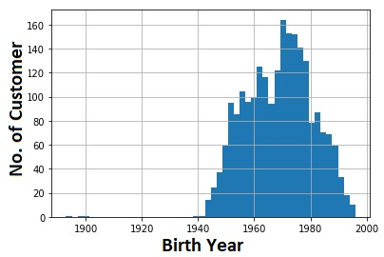
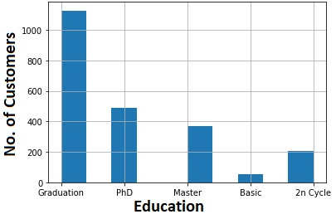
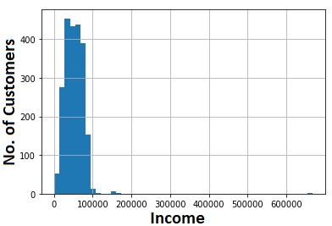
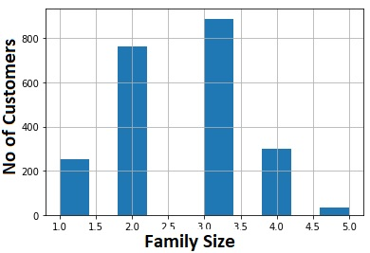
LOADING DATA & ANALYSING IT

Slide 7
ADDING ATTRIBUTES/FEATURES, DATA CLEANING & DATA PREPROCESSING
CREATED FEATURES
CUSTOMER SENIORITY
TOTAL SPENT
FAMILY SIZE
NO. OF TOTAL PURCHASE
NO OF CAMPAIGN ACCEPTED
REDEFINED FEATURES
EDUCATION
MARRIAGE/LIVING STATUS
RENAMED PURCHASED ITEM COLUMN

Slide 8
ADDING ATTRIBUTES/FEATURES, DATA CLEANING & DATA PREPROCESSING
PLOT THE PAIRPLOT OF ALL NEW FEATURE WITH CUSTOMER DETAILS
REMOVED THE OUTLINERS
DROPPED THE LESS RELEVANT COLUMNS
CONVERTED THE CATEGORICAL FEATURE TO NUMERICAL FEATURE USING LABELENCODER
SCALED THE FEATURE USING STANDARD SCALER
DIMENSIONALITY REDUCTION (USING PCA)
CREATING THE FINAL DATASET FOR MODEL

Slide 9
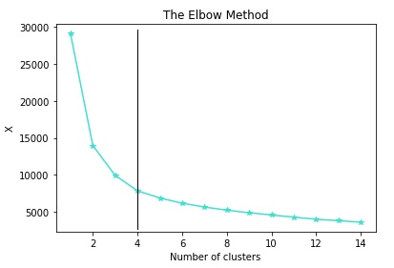
MODEL SELECTION/TRAINING THE MODEL
FINDING NUMBER OF CLUSTERS THROUGH KMEANS
ELBOW METHOD TO DETERMINE THE NUMBER OF CLUSTERS TO BE FORMED
CLUSTERING VIA AGGLOMERATIVE CLUSTERING
FORMING THE CLUSTER IN DATASET
EXAMINING THE CLUSTERS FORMED VIA SCATTER PLOT

Slide 10
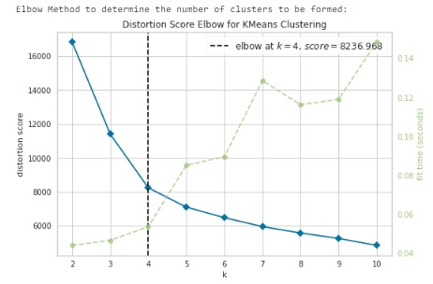
FIND THE ELBOW

Slide 11
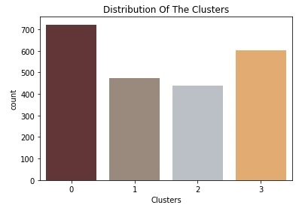
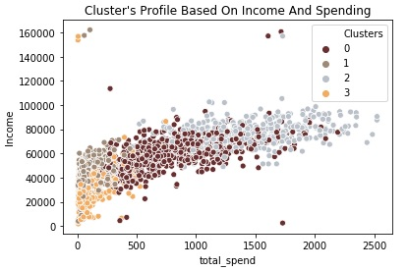
CLUSTERING
INCOME VS SPENDING PLOT SHOWS THE CLUSTERS PATTERN
GROUP 0: HIGH SPENDING & AVERAGE INCOME
GROUP 1: LOW SPENDING & AVERAGE INCOME
GROUP 2: HIGH SPENDING & HIGH INCOME
GROUP 3: LOW SPENDING & LOW INCOME

Slide 12
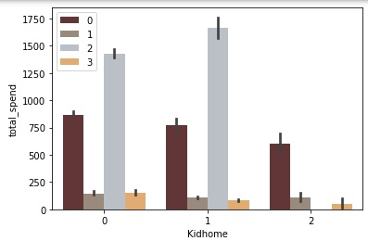
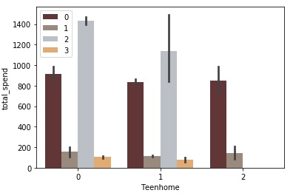
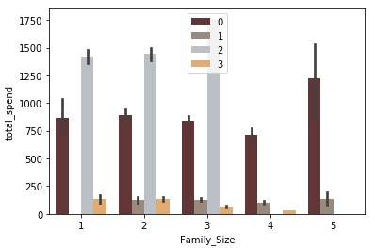
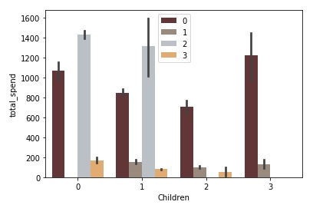
PROFILING

Slide 13
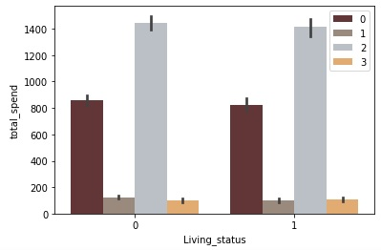
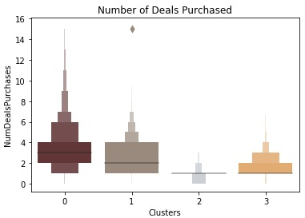
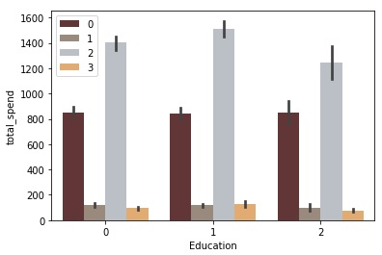
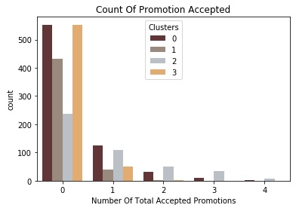
PROFILING

Slide 14
PROFILING
GROUP 0
GROUP 1
The majority of these people are not a parents
At the max are 5 members in the family and at least 2
Majority of them have Children
Single parents are subset of this group
High spending & average income
Relatively older + Senior member
Some of them are parent
At the max have 4 members in the family
Single parents are subset of this group
Low spending & average income
Most have a Children at home
Relatively older + Senior member
GROUP 2
GROUP 3
The majority of these people are not a parents
At max are 3 members in family
Majority have one kid
Single parents are subset of this group
Relatively younger
High spending & High income
Are a definitely a parent
At max are only 5 members in the family and at least 2
Definitely have at least a children
A slightly majority of couples over single people
Span all ages
Low spending & low income

Slide 15
CONCLUSION
PERFORMED UNSUPERVISED CLUSTERING
DID DATA ANALYSIS, ADD FEATURES & DATA CLEANING
DIMENSIONALITY REDUCTION
PERFORMED CLUSTERING USING KMEANS & AGGLOMERATIVE ML ALGORITHMS
MADE 4 CLUSTERS AND FURTHER PROFILING OF CUSTOMERS
CAN BE USED IN FOLLOWING:
PLANNING BETTER MARKETING STRATEGIES
PLANNING BETTER PRODUCTS & SERVICE CUSTOMER SEGMENT WISE
CLUSTER/ PROFILE WISE PRODUCT/SERVICE CONSUMPTION PATERN
INCOME AND SPENDING BEHAVIOUR OF CUSTOMER

